Slide 1
SmartCare
Clinic Management System built on Zoho Creator
Low-code | Deluge scripting | Workflows | Role-based security
Umar Farook K (240701573)
B.E. Computer Science and Engineering, Rajalakshmi Engineering College
CB23F35 – Low-Code Application Development using Zoho Creator | November 2026
Notes:
Introduce yourself and the project: SmartCare is a clinic management system built on Zoho Creator for the CB23F35 individual project.

Slide 2
Problem and Objectives
The problem
Objectives
Records scattered across registers and spreadsheets
Patient codes assigned by hand, so duplicates
No controlled appointment status
Informal leave approvals, manual reports
Forms and data model for six modules
Automate codes, validation, e-mails, approvals
Dashboard and reports for live visibility
Role-based protection of sensitive data
Why low-code?
Rapid build, built-in hosting, security and mobile access
Who uses it?
Admin, receptionist, doctor, pharmacist, patient
Where?
Web, tablet and phone layouts
SmartCare – Clinic Management System | Umar Farook K (240701573)
2
Notes:
Explain the manual process first, then show how each objective answers a pain point.

Slide 3
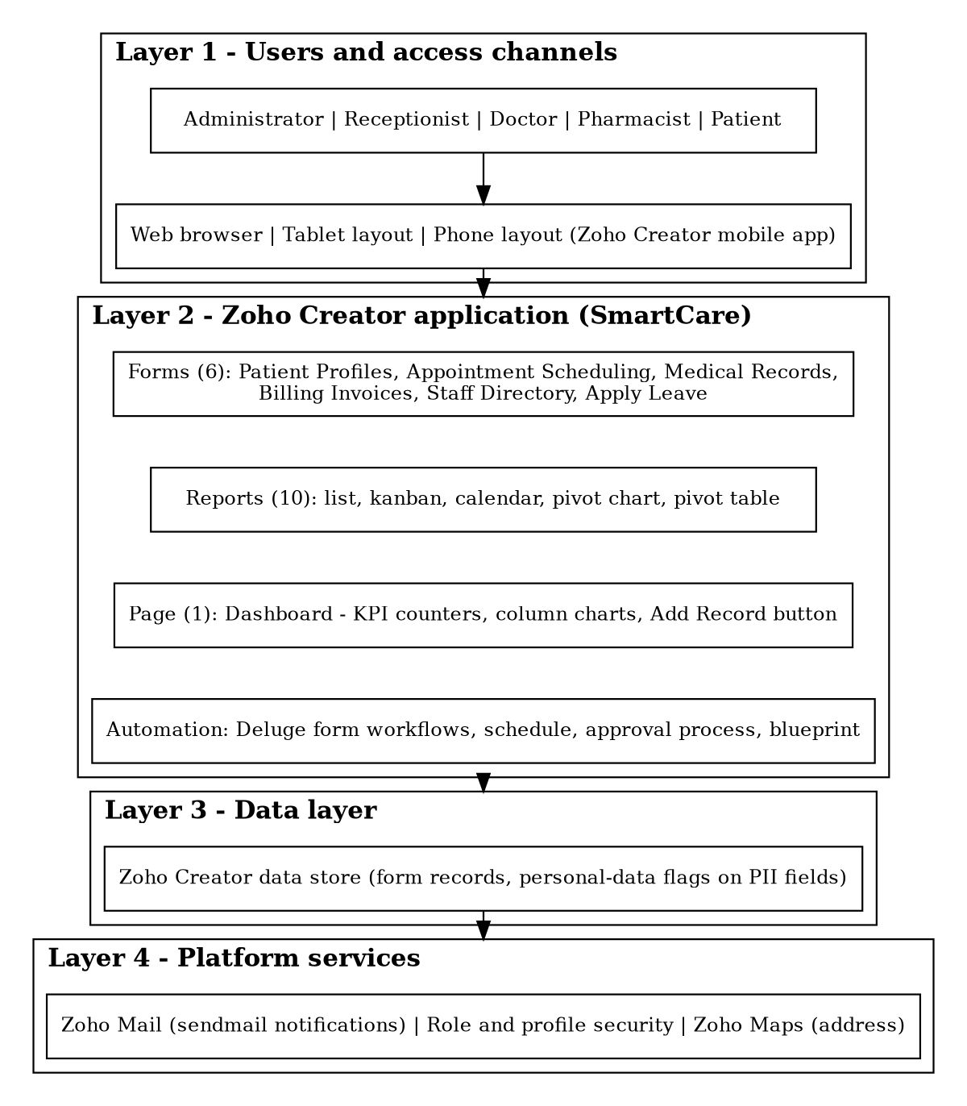
The Solution at a Glance
6
59
Forms
Fields
13
10
Field types
Reports
1
5
Dashboard
Workflows
2
6
Deluge scripts
Roles
SmartCare – Clinic Management System | Umar Farook K (240701573)
3
Notes:
Walk through the numbers, then the layered architecture on the right.

Slide 4
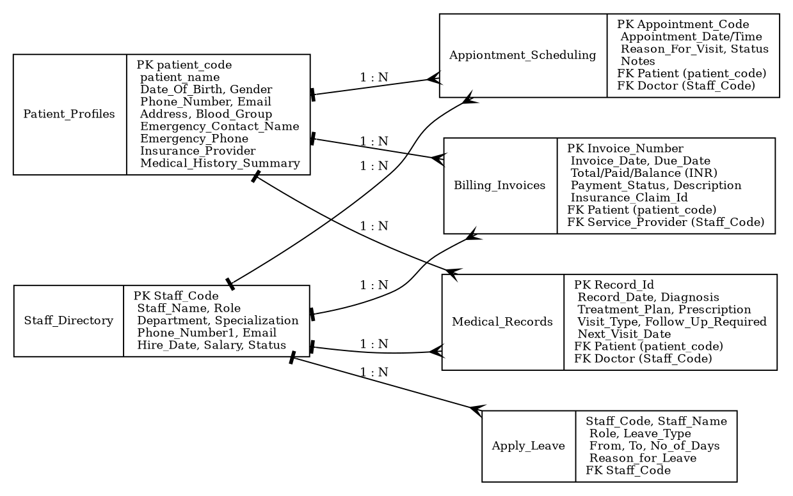
Data Model and Forms
Master entities
Patient Profiles
Staff Directory
Transaction forms
Appointments, Medical Records
Billing Invoices, Apply Leave
Field types used
Text, date, time, drop down
Name, phone, e-mail, address
Currency, checkbox, number
SmartCare – Clinic Management System | Umar Farook K (240701573)
4
Notes:
Six entities. Patients and staff are masters; links are held as code pick lists, to be replaced by lookups.

Slide 5
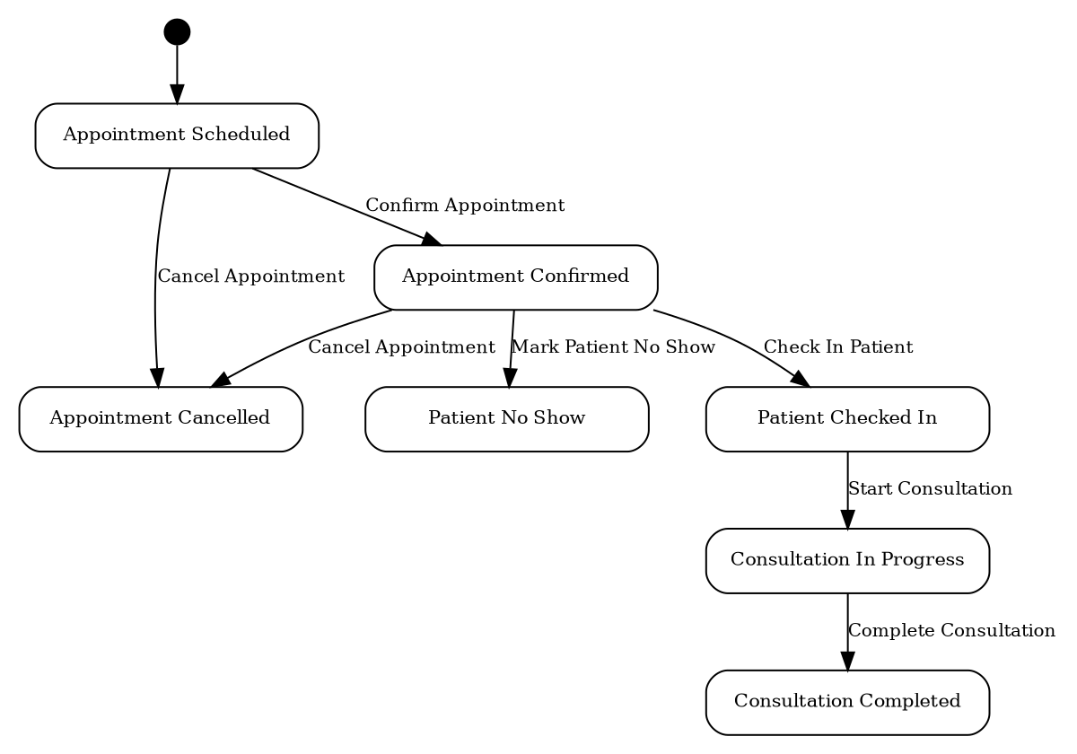
Automation: Scripts, Workflows and Blueprint
Patient registration flow
DS-01 generates unique patient code on form load
1
Receptionist fills patient details
2
DS-02 checks the code on validate
3
Duplicate: alert and cancel. Otherwise: saved
4
Appointment blueprint: 7 stages, 7 transitions
Also automated
Scheduled follow-up reminder is defined and ready to activate
E-mail on new appointment; leave approval with e-mailed outcome
SmartCare – Clinic Management System | Umar Farook K (240701573)
5
Notes:
Show DS-01 and DS-02 first, then the blueprint stages.

Slide 6
Reports, Dashboard and Security
Profile | Admin | Doctor | Patient
Permissions | A E V D | A E V | A V
Dashboard
Total patients and total doctors
Blood-group and role charts
Add Record button for appointments
A = Add, E = Edit, V = View, D = Delete. Six roles; personal-data flags on sensitive fields.
SmartCare – Clinic Management System | Umar Farook K (240701573)
6
Notes:
Left chart: fields per form. Middle: report types. Right: permissions by profile.

Slide 7
Results, Limitations and Future Work
Outcomes
Limitations
Next steps
No manual patient coding
Visible appointment status
Recorded leave decisions
Live reports
Code pick lists, not lookups
No record-level access
No external integrations
Reminder schedule inactive
Lookups and subforms
Patient-only record access
SMS and payments
Zia AI, Catalyst PDFs
A full clinic workflow built with six forms and only two short scripts.
Thank you | Questions?
SmartCare – Clinic Management System | Umar Farook K (240701573)
7
Notes:
Be candid about limitations: they show you understand the platform.

